Slide 1
DIGITAL PORTFOLIO
STUDENT NAME : SUVARNA LAKSHMI.M
REGISTER NO AND NMID: ASBRU4W2422K2146
DEPARTMENT : BSC.COMPUTER SCIENCE
COLLEGE: BHARATHIYAR UNIVERSITY

Slide 2

Project title
Suvarna’s portfolio

Slide 3
AGENDA
Project statement
Project overview End users Tools and technologies Portfolio design and layout Features and functionality Results and screenshots Conclusion GitHub link

Slide 4
PROBLEM STATEMENT
In the modern academic and professional world, students need a platform to
*showcase their skills, projects, achievements, and experiences*. Traditional resumes
are often limited in content and engagement. A *digital portfolio* offers a more
dynamic, organized, and accessible way to present one’s profile. *The goal of this project is to *design and develop a personal digital portfolio website* that allows a student to display their: - Academic background - Technical and soft skills - Projects and certifications - Internships or experience - Contact information and links (GitHub, LinkedIn, etc.)

Slide 5
PROJECT OVERVIEW
This project involves creating a *personal digital portfolio website* for a college student. The portfolio serves as an online resume and showcase of the student’s academic journey, technical skills, and projects. It allows potential employers, teachers, and collaborators to easily access the student’s background, achievements, and contact information
• The website is designed using *HTML, CSS, and JavaScript*, ensuring it is *responsive*, *user-friendly*, and *visually appealing* across different devices. It includes sections such as *About Me*, *Skills*, *Projects*, *Education*, and *Contact*. The project not only highlights the student’s work but also demonstrates their web development abilities.
• This digital portfolio acts as a personal brand, helping the student stand out in academic and professional settings

Slide 6
WHO ARE THE END USER’S ?
1. *Employers/Recruiters* – To evaluate the candidate’s skills, projects, and suitability for jobs. 2. *College Admission Officers* – To assess student profiles during higher education applications. 3. *Clients (for Freelancers)* – To check previous work before hiring. 4. *Teachers/Mentors* – To review student performance and growth. 5. *Peers & Collaborators* – To understand someone’s capabilities for teamwork.
6. *The Student (Owner)* – To self-promote, reflect, and update progress regularly.

Slide 7
TOOLS AND TECHNIQUES OF HTML
HTML (HyperText Markup Language) is the foundation of web development, and creating web pages with it involves various tools and techniques.Commonly used tools include text editors like Visual Studio Code, Sublime Text, and Notepad++, which allow developers to write and manage HTML code efficiently. Web browsers such as Chrome or Firefox are essential for testing and previewing how the web pages render. Developers often use browser developer tools (like Chrome DevTools) to inspect elements and debug code. Techniques in HTML involve writing semantic tags (e.g., `<header>`, `<footer>`, `<section>`) to create meaningful structure, ensuring better readability and accessibility. Other important practices include embedding images, videos, and links, creating responsive layouts with the help of CSS,and using forms to collect user input. Together, these tools and techniques help build clean, user-friendly, and functional web pages.

Slide 8
TOOLS AND TECHNIQUES CSS
*CSS (Cascading Style Sheets)* is used to style and design HTML web pages. The tools and technologies used with CSS help developers create responsive, attractive, and well-structured web layouts.
CSS development typically involves tools like *code editors* such as Visual Studio Code, Sublime Text, or Atom, which offer syntax highlighting and live preview support. *Browser Developer Tools* (e.g., Chrome DevTools) are essential for testing and debugging CSS in real-time. Technologies like *CSS Grid* and *Flexbox* are used to create responsive layouts, while *media queries* enable websites to adapt to different screen sizes. Developers also use *CSS frameworks* such as Bootstrap, Tailwind CSS, or Bulma to speed up styling with pre-defined classes and components. Tools like *Preprocessors* (e.g., SASS or LESS) allow writing more manageable, modular CSS with features like variables and nesting. Combined, these tools and technologies help in building modern, responsive, and visually appealing websites efficiently.

Slide 9
TOOLS AND TECHNIQUES JAVASCRIPT
◆ *JavaScript* is a powerful scripting language used to make web pages interactive and dynamic. Various tools and techniques are used to write, test, and optimize JavaScript code effectively.
◆ Common *tools* include *code editors* like Visual Studio Code, Sublime Text, and Atom, which offer features like IntelliSense and debugging support. *Browsers* (such as Chrome and Firefox) come with built-in *developer tools* (like Chrome DevTools) that help inspect elements, debug JavaScript code, and monitor performance. Developers often use *version control tools* like Git and GitHub for managing and sharing code. For advanced development, *build tools* like Webpack, Babel, and NPM help bundle and optimize JavaScript files.
◆ Popular *techniques* in JavaScript include *DOM manipulation* to change HTML content dynamically, *event handling* to respond to user actions, and *AJAX/fetch API* for loading data without refreshing the page. Other techniques involve using *functions*, *loops*, *conditional statements*, and working with *objects and arrays* to manage data. Together, these tools and techniques make JavaScript essential for creating modern, interactive websites and web applications.

Slide 10
PORTFOLIO DESIGN AND LAYOUT
The design and layout of a digital portfolio play a crucial role in how effectively it presents information. A well-structured portfolio typically follows a clean, user-friendly layout with clearly defined sections such as a *header*, *about me*, *skills*, *projects*, *education*, and *contact information*. The *navigation bar* allows users to easily move between these sections. Visually, the portfolio should maintain a consistent color scheme, typography, and spacing to ensure a professional look. Responsive design is essential so the portfolio looks good on all devices, including phones and tablets. Elements like images, icons, and buttons should be used meaningfully without cluttering the page. A balanced layout with proper alignment and white space improves readability and user experience, helping visitors focus on the content without distraction

Slide 11
FEATURE AND FUNCTIONALITY
A digital portfolio offers several key features to effectively showcase an individual’s skills and achievements. It typically includes *personal information* like name, photo, and contact details for easy communication. The portfolio highlights *skills* and *technical abilities* with organized sections or visual indicators. It showcases *projects* with descriptions, images, and links to live demos or code repositories.
The portfolio is designed to be *responsive*, ensuring it looks good on desktops, tablets, and smartphones. It often includes *navigation menus* for smooth browsing between sections. Some portfolios have *interactive elements* like dark mode toggles, animations, or real-time updates (e.g., displaying current time). Contact forms enable visitors to send messages directly. Additionally, integration with social media and platforms like GitHub or LinkedIn allows users to connect and verify work
Overall, the functionality ensures the portfolio is easy to update, visually appealing, and accessible to potential employers, educators, or collaborators.

Slide 12
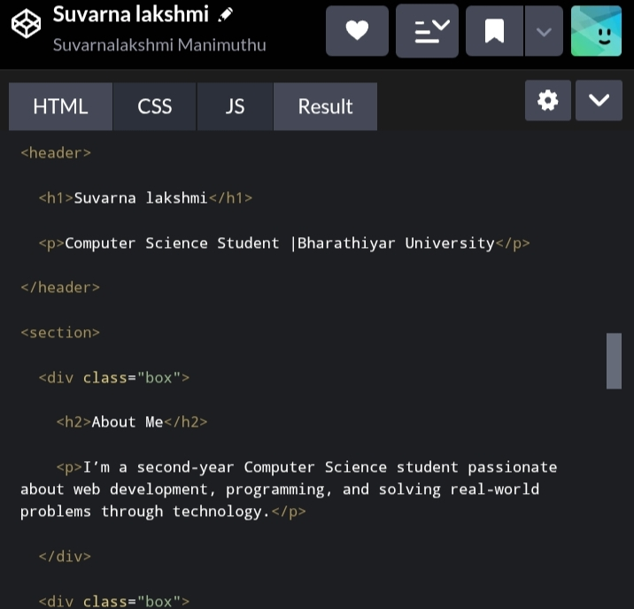
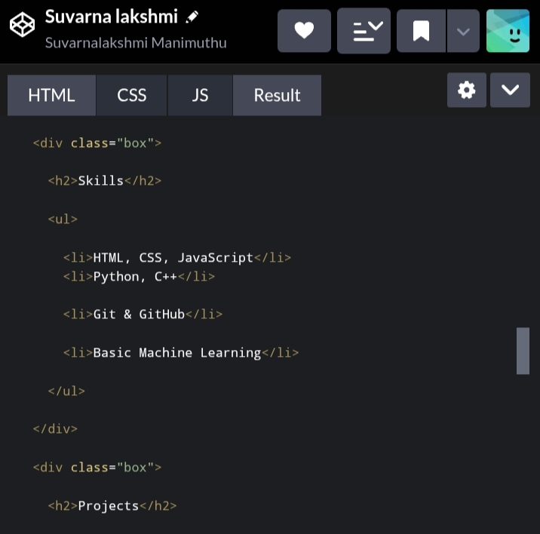
RESULTS AND SCREENSHOT

Slide 13
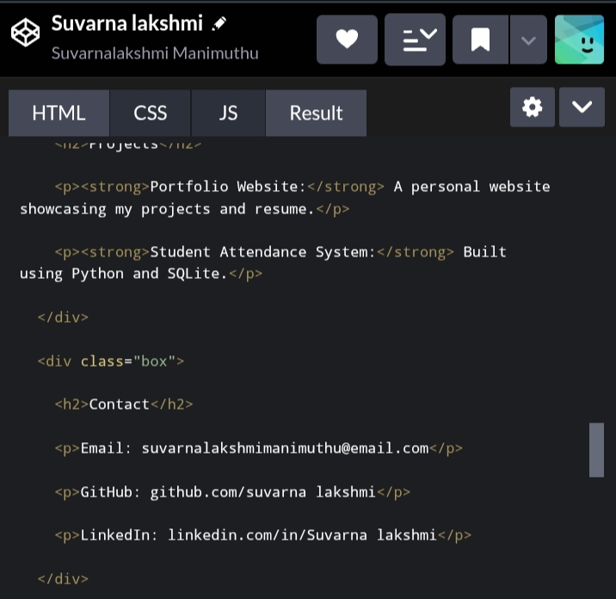
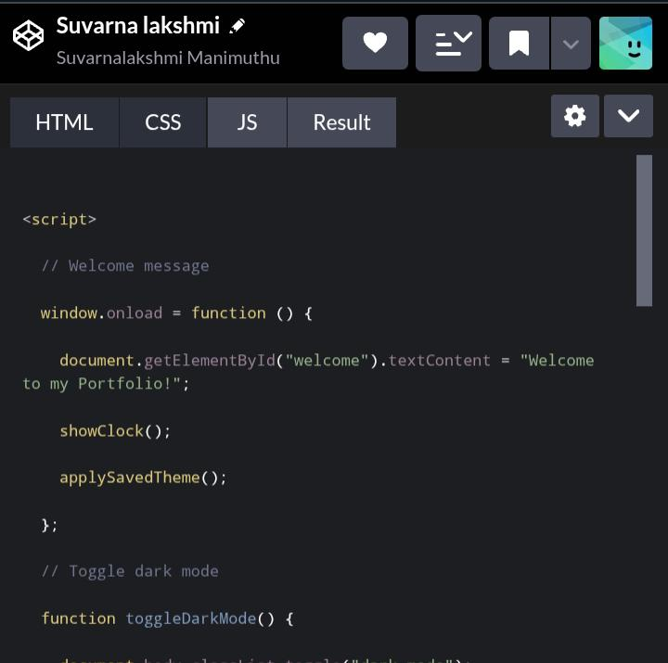
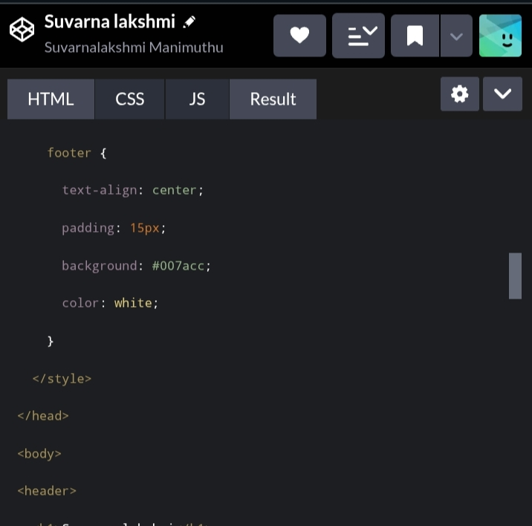
Results and screenshots

Slide 14
Conclusion
Creating a digital portfolio is an effective way for students and professionals to showcase their skills, projects, and achievements in a modern, accessible format. It provides a dynamic platform that goes beyond traditional resumes by offering visual appeal and interactivity. A well-designed portfolio helps individuals stand out to employers, educators, and collaborators by presenting their work clearly and professionally. Additionally, maintaining a digital portfolio encourages continuous learning and self-promotion, which are essential in today’s competitive world. Overall, a digital portfolio is a valuable tool for personal branding and career growth.

